Slide 1

RAISE: A Randomized, Double-Blind, Multicenter Phase III Study of Irinotecan, Folinic Acid, and 5-Fluorouracil (FOLFIRI) Plus Ramucirumab or Placebo in Patients With Metastatic Colorectal Carcinoma Progression During or Following First-Line Combination Therapy With Bevacizumab, Oxaliplatin, and a Fluoropyrimidine
Abstract 512
Tabernero J, Cohn AL, Obermannova R, Garcia-Carbonero R, Ciuleanu T-E, Portnoy DC, Van Cutsem E, Grothey A, Prausová J, Garcia-Alfonso P, Yamazaki K, Clingan PR, Zagonel V, Kim TW, Simms L, Change S-C, Nasroulah F, Yoshino T, The RAISE Study Investigators

Slide 2
Introduction
Colorectal carcinoma (CRC) is the fourth most common cause of cancer death worldwide.
VEGF and VEGFR-2 mediated signaling and angiogenesis are important in CRC tumor growth and are established therapeutic targets.
Ramucirumab is a recombinant human IgG1 monoclonal antibody that binds to the extracellular domain of VEGFR-2, preventing ligand binding and receptor activation.
The RAISE study evaluated the efficacy and safety of adding ramucirumab to the standard second-line treatment FOLFIRI following progression after first-line bevacizumab, oxaliplatin, and a fluoropyrimidine.
Tabernero J, et al. J Clin Oncol. 2015;33(suppl 3): Abstract 512.

Slide 3

Trial Design
Ramucirumab (8 mg/kg) and FOLFIRI* every 2 weeks per cycle N = 536
Treatment until disease progression or unacceptable toxicity
Primary endpoint: Overall survival
Progression during or after bevacizumab, ocaliplatin, and a fluorpyrimidine
Placebo and FOLFIRI* every 2 weeks per cycle
N = 536
*Irinotecan: 180 mg/m2; Folinic acid: 400 mg/m2; 5-Fluorouracil 400 mg/m2 bolus, followed by 2400 mg/m2 administered intraveniously over 46 to 48 hours (continuously)
Stratification factors:
Geographic regions
KRAS mutation status
Time to disease progression after beginning first-line therapy
Sample size assumptions:
Hazard ratio of 0.8
Median overall survival of 10 months in the control arm vs 12.5 months with ramuciruman with a 2-sided α level of 0.05
Enrollment of 1050 patients with 756 events for 85% power
Gatekeeping from OS to PFS to ORR
IG, immunogenicity; PFS, prorgession-free survival; PK, pharmacokinetics; OS, overall survival; ORR, objective response rate
Tabernero J, et al. J Clin Oncol. 2015;33(suppl 3): Abstract 512.

Slide 4
Key Inclusion Criteria
  Diagnosis of metastatic CRC (histological or cytological confirmation)
  Known KRAS mutation status
  Eastern Cooperative Oncology Group performance status score of 0 or 1
  Documented progressive disease during or after a first-line combination therapy of bevacizumab, oxaliplatin, and a fluoropyrimidine
  At least two doses of bevacizumab in first-line therapy
  Disease progression ≤6 months after the last dose of first-line therapy
  Adequate hematologic and biochemical parameters
Tabernero J, et al. J Clin Oncol. 2015;33(suppl 3): Abstract 512.

Slide 5
Key Exclusion Criteria
  Previous first-line systemic therapy, other than a combination of bevacizumab, oxaliplatin, and a fluoropyrimidine
  Uncontrolled hypertension
  Arterial thrombotic event within 12 months
  Received bevacizumab ≤28 days or chemotherapy ≤21 days prior to randomization
  Known brain metastasis
  Grade 3 or higher bleeding event ≤3 months prior to randomization
Tabernero J, et al. J Clin Oncol. 2015;33(suppl 3): Abstract 512.

Slide 6
Baseline Characteristics
 | Ramucirumab + FOLFIRI (N = 536) | Placebo + FOLFIRI (N = 536)
Median age (range), years | 62 (21-83) | 62 (33-87)
Age group, n (%) ≥65 years | 212 (39.6) | 215 (40.1)
Male, n (%) | 289 (53.9) | 326 (60.8)
Race, n (%)
Caucasian | 405 (75.6) | 410 (76.5)
Asian | 111 (20.7) | 103 (19.2)
ECOG PS, n (%)
0 | 263 (49.1) | 259 (48.3)
1 | 268 (50.0) | 273 (50.9)
Number of metastatic sites, n (%)
1 | 171 (31.9) | 157 (29.3)
2 | 205 (38.2) | 194 (36.2)
≥3 | 157 (29.3) | 182 (34.0)
Liver only metastasis, n(%) Yes | 92 (17.2) | 95 (17.7)
Carcinoembryonic antigen, n (%)
<200 µg/L | 389 (72.6) | 393 (73.3)
≥200 µg/L | 108 (20.1) | 107 (20.0)
Some patients may be missing from some categories
Tabernero J, et al. J Clin Oncol. 2015;33(suppl 3): Abstract 512.

Slide 7
Patient Disposition
Screened (N = 1361)
Patients randomized (1:1 randomization)
(n = 1072)
Ramucirumab arm (n = 536)
ITT Population
Placebo arm (n = 536)
Did not receive treatment (n = 8)
Did not receive treatment (n = 7)
Ramucirumab arm*
(n = 529)
Safety population
(n = 1057)
Placebo arm* (n = 528)
On treatment (n = 18)
On treatment (n = 15)
Treatment discontinuation
 | n | %
Progressive disease | 338 | 63
Subject decision | 49 | 9
Death | 18 | 3
Withdrawel of consent | 8 | 1
Lost to follow-up | 0 | 0
Adverse event | 59 | 11
Other | 4 | <1
Investigator decision | 35 | 7
Total | 511 | 95
 | n | %
Progressive disease | 417 | 78
Subject decision | 26 | 5
Death | 13 | 2
Withdrawel of consent | 4 | <1
Lost to follow-up | 0 | 0
Adverse event | 23 | 4
Other | 5 | <1
Investigator decision | 25 | 5
Total | 513 | 96
ITT, intent-to-treat; N, number of patients in category; One patient was randomized to the placebo group but received ramucirumab
Tabernero J, et al. J Clin Oncol. 2015;33(suppl 3): Abstract 512.

Slide 8
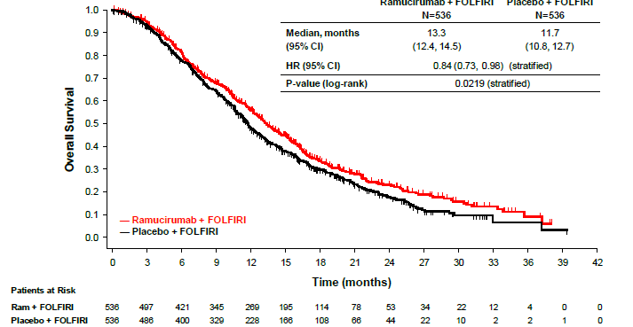
Overall Survival
 | Ramicurimab + FOLFIRI N = 536 | Placebo + FOLFIRI N = 536
Median, months (95% CI) | 13.3 (12.4,14.5) | 11.7 (10.8, 12.7)
HR (95% CI) | 0.84 (0.73, 0.98) (stratified)
P value (log-rank) | .0219 (stratified)
CI, confidential interval; HR, hazard ratio; Ram, ramicurimab
Tabernero J, et al. J Clin Oncol. 2015;33(suppl 3): Abstract 512.

Slide 9
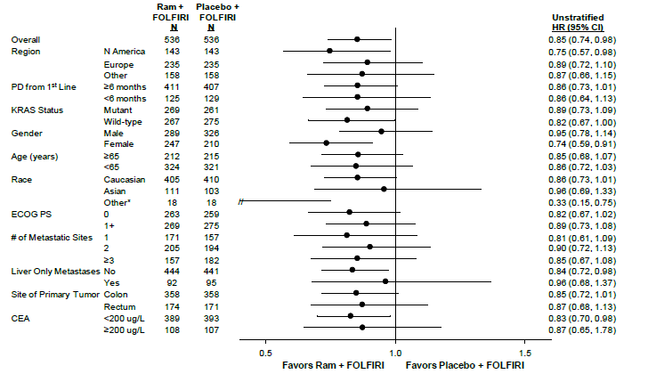
Overall Survival by Subgroup
CEA, carcinoembryonic antigen; ECOG PS, Eastern Cooperative Oncology Group performance status; N, number of patients;
PD, progressive disease
Tabernero J, et al. J Clin Oncol. 2015;33(suppl 3): Abstract 512.

Slide 10
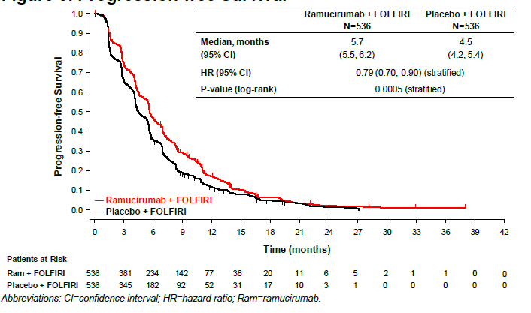
Progression-Free Survival
 | Ramicurimab + FOLFIRI N = 536 | Placebo + FOLFIRI N = 536
Median, months (95% CI) | 5.7 (5.5, 6.2) | 4.5 (4.2, 5.4)
HR (95% CI) | 0.79 (0.70, 0.90) (stratified)
P value (log-rank) | .0005 (stratified)
Tabernero J, et al. J Clin Oncol. 2015;33(suppl 3): Abstract 512.

Slide 11
Tumor Response
 | Ramicurimab + FOLFIRI N = 536 % | Placebo + FOLFIRI N = 536 % | P-value
Response rate (CR+PR) | 13.4 | 12.5 | .6336
Disease control rate (CR+PR+SD) | 74.1 | 68.8 | .0587
Complete response | 0 | 0.4
Partial response (PR) | 13.4 | 12.1
Stable disease (SD) | 60.6 | 56.3
Progressive disease (PD) | 16.2 | 25
Not done or unknown | 9.7 | 6.2
Tumor assessments based on RECIST 1.1
Tabernero J, et al. J Clin Oncol. 2015;33(suppl 3): Abstract 512.

Slide 12
Post-Treatment Anticancer Therapy
 | Ramicurimab + FOLFIRI N = 536 % | Placebo + FOLFIRI N = 536 %
Systemic anticancer therapy | 54.1 | 56.0
Fluoropyrimidines | 33.4 | 34.0
Irinotecan | 30.6 | 28.7
Anti-EGFR antibody (cetuximab or panitumumab) | 25.6 | 28.5
Anti-angiogenic agents (bevacizumab or aflibercept) | 12.7 | 13.1
Regorafenib | 10.4 | 10.8
Platinum | 9.0 | 10.8
Tabernero J, et al. J Clin Oncol. 2015;33(suppl 3): Abstract 512.

Slide 13
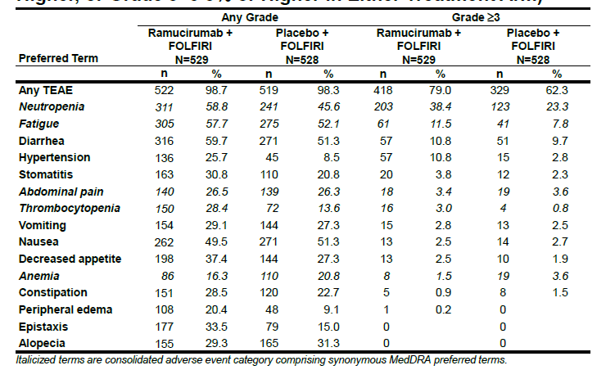
Treatment-Emergent Adverse Events
Tabernero J, et al. J Clin Oncol. 2015;33(suppl 3): Abstract 512.

Slide 14
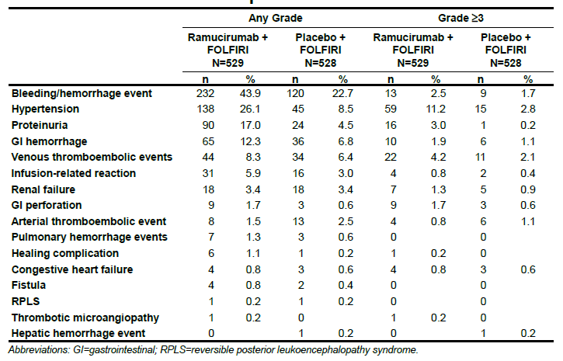
Adverse Events of Special Interest
Tabernero J, et al. J Clin Oncol. 2015;33(suppl 3): Abstract 512.

Slide 15
Conclusions
RAISE met its primary endpoint.
  Demonstrated a statistically significant improvement in overall survival for ramucirumab and FOLFIRI vs placebo and FOLFIRI
  In second-line metastatic CRC patients who progressed after first-line treatment with bevacizumab, oxaliplatin, and a fluoropyrimidine
Consistent survival benefits were observed across subgroups
Ramucirumab in combination with FOLFIRI was well tolerated in patients with mCRC; overall, the adverse events were considered manageable
Tabernero J, et al. J Clin Oncol. 2015;33(suppl 3): Abstract 512.

